Slide 1
Orientation to
Service Insights
Digital Client Intake at Your Pantry
™

Slide 2
Introductions
Tell us a bit about yourself and your organization
Why are you interested in Service Insights?

Slide 3
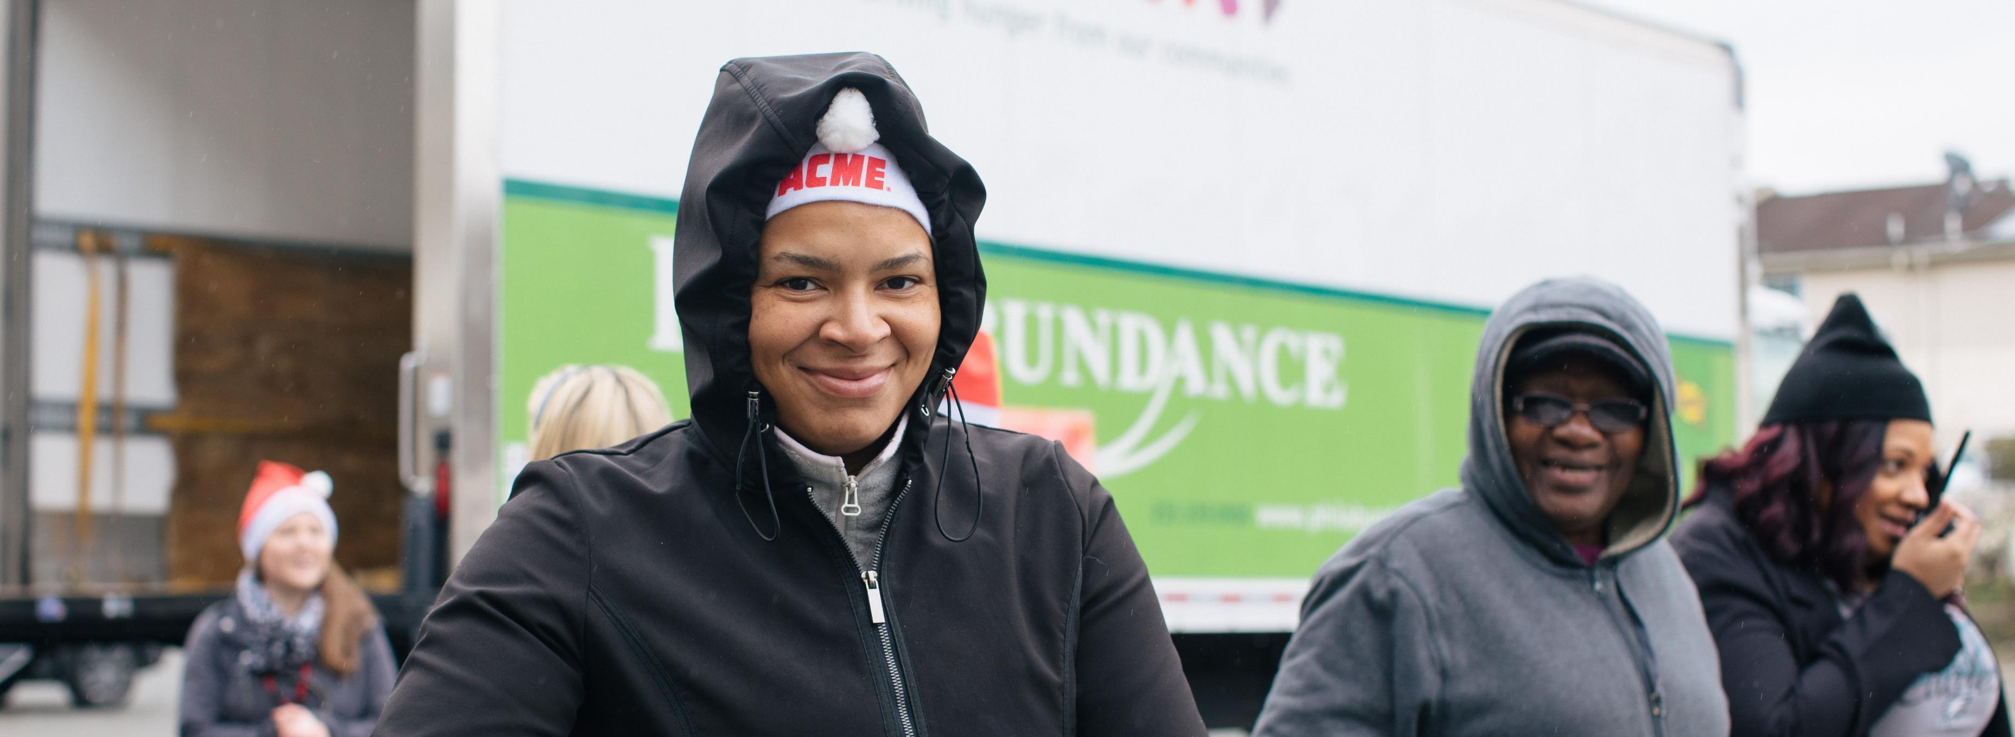
Orientation Agenda:
Goals for Today
Service Insights – the Whats and Whys
How it Works
Demonstration
What’s Next?

Slide 4
Our Goals
You will …
Understand how the Service Insights system works
Understand your options for using Service Insights at your pantry
Learn how CAFB will support your use of Service Insights
Feel confident in explaining Service Insights to your clients and fellow volunteers/staff
Know what steps to take next
You’ll get everything in a follow-up email

Slide 5
What is Service Insights (SI)?
Service Insights is an initiative for food banks across the country to equip themselves with information tools to learn more about the communities we serve.
We can’t meet the needs of our community if we don’t understand them.
*unduplicated data to drive decision-making*
Notes:
Real time, unduplicated data

Slide 6
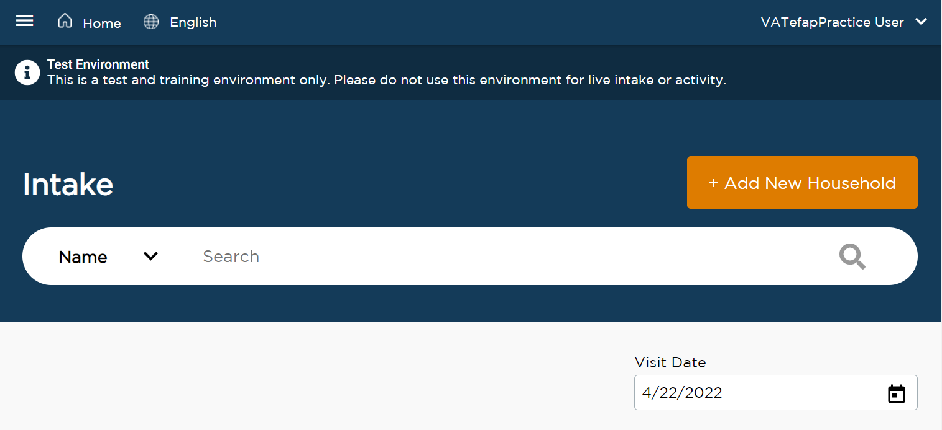
Service Insights is Digital Client Intake
Client intake is collecting basic demographic data from people receiving food
Such as: name, age, ethnicity, household members
Service Insights is client intake using a computer system – quick, fast, and easy! You’ll get up-to-the-minute reports on your impact.
The system is developed by Feeding America specifically for food banks and food pantries

Slide 7
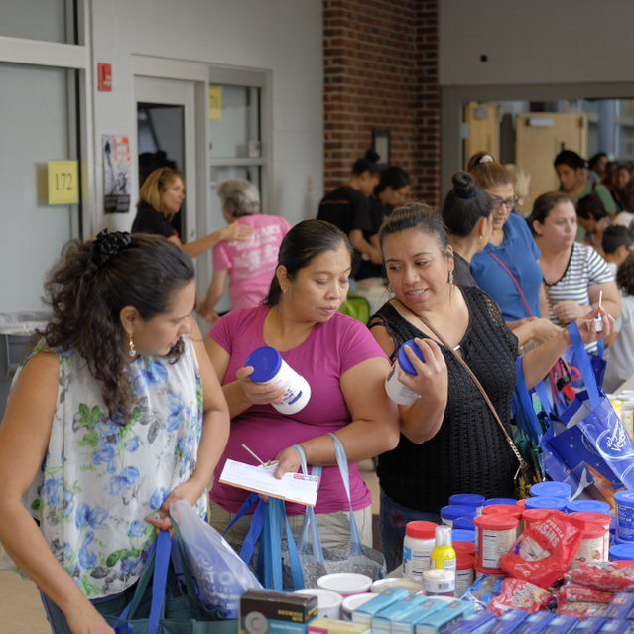
Benefits to You, Our CAFB Partners
Minimize paperwork
Track food and non-food services in one system
Use reports to easily provide info for grants
Order more appropriate food for your pantry
Analyze and change your outreach
Ongoing system support from CAFB

Slide 8
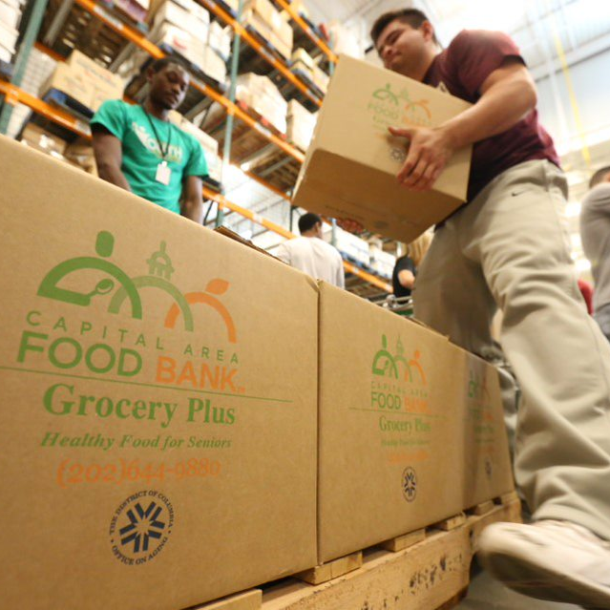
How will CAFB use the data collected?
Procure food for all our cultures, age groups, and health conditions
Better serve areas without enough food resources
Provide grants to partners serving focus populations
Advocate for clients in local & federal government
And more – all in the service of our community

Slide 9
Data Usage
Service Insights provides more insight on our communities by collecting additional information.
This information can be used by:
Capital Area Food Bank
Feeding America
And you, our partners.
Notes:
State agencies = MD DHS, DC OSSE, or VDACS
More detail in FAQ

Slide 10
Service Insights is Secure
All information in Service Insights is powerfully protected and encrypted.
No personal information will ever be shared with anyone outside of our partner network.
We will never share personal info with agencies like law enforcement and immigration services.
Clients are not required to provide their information in Service Insights in order to receive food or services.

Slide 11
Let’s see a quick preview!

Slide 12
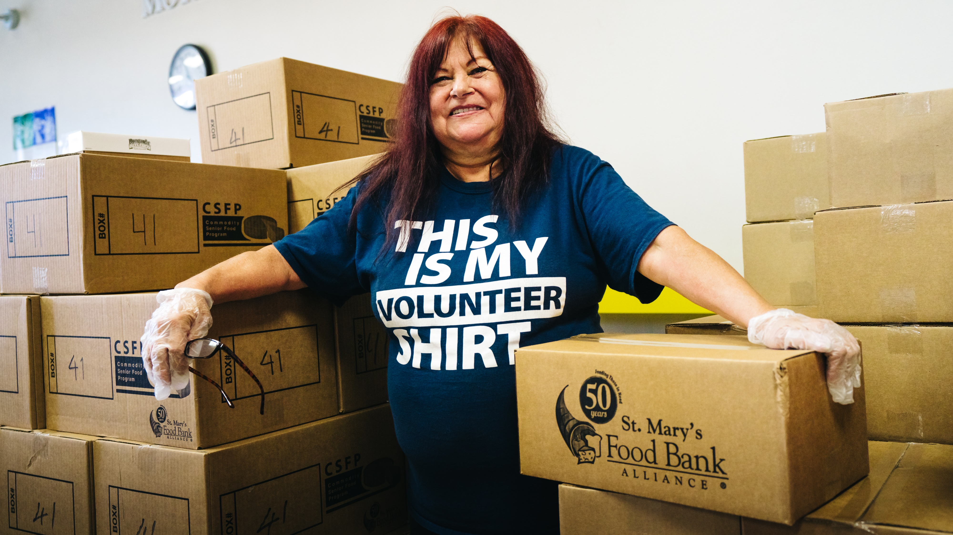
How it Works

Slide 13
Technical Requirements
Service Insights is web-based – we can use laptops, tablets, and/or smartphones connected to the internet
Compatible internet browsers
Safari (iPads and iPhones)
Google Chrome
Mozilla Firefox
NOT recommended: Internet Explorer, Microsoft Edge, Silk (sometimes found on Kindle tablets)

Slide 14
Clients only need to register one time in Service Insights.
Clients are not registering at your site; they are registering in the CAFB Network.
All Partners using the system will work together to keep clients’ info updated.
Notes:
Everyone’s recertification is 1 year

Slide 15
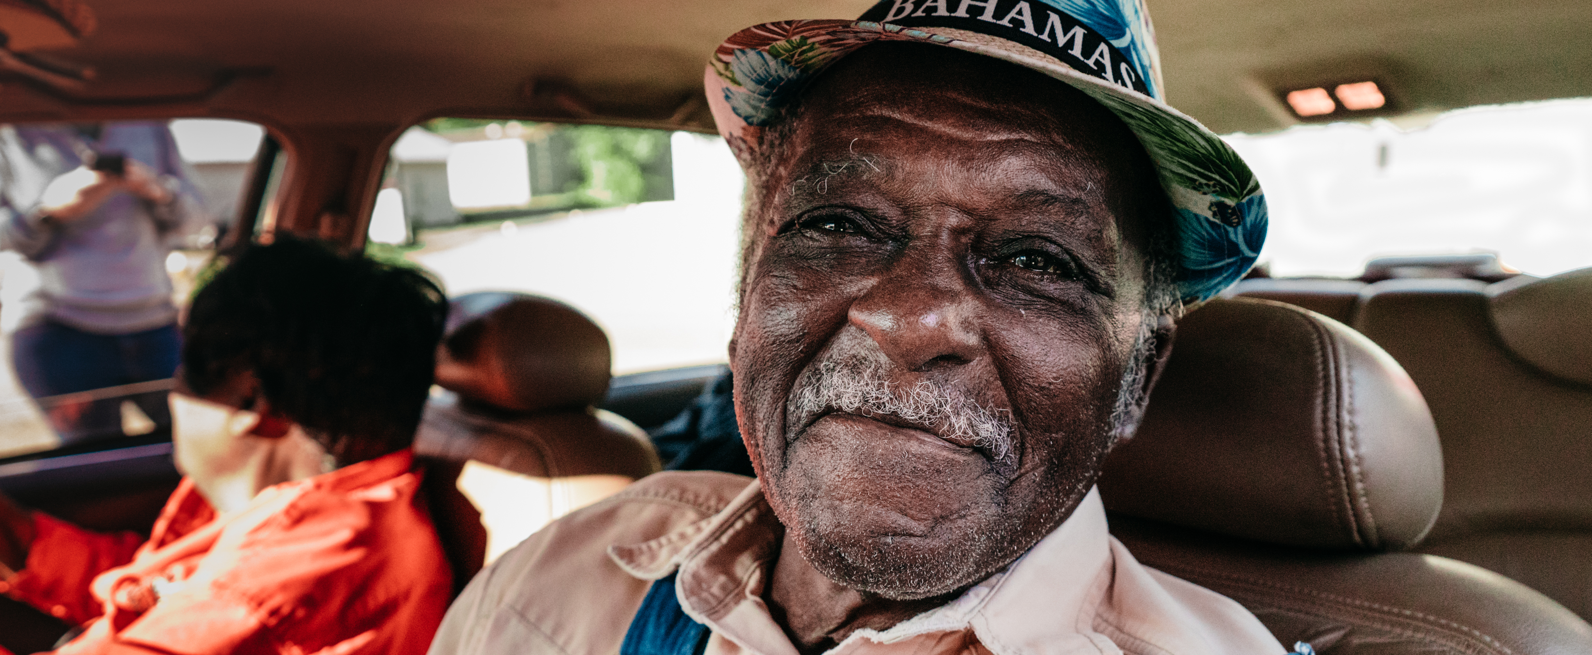
Partners should start fresh collecting information from clients during your distribution.
When you collected clients’ info before, they did not know that you might enter it into the Service Insights system.
Notes:
Mention Your Data Your Rights poster/handout

Slide 16
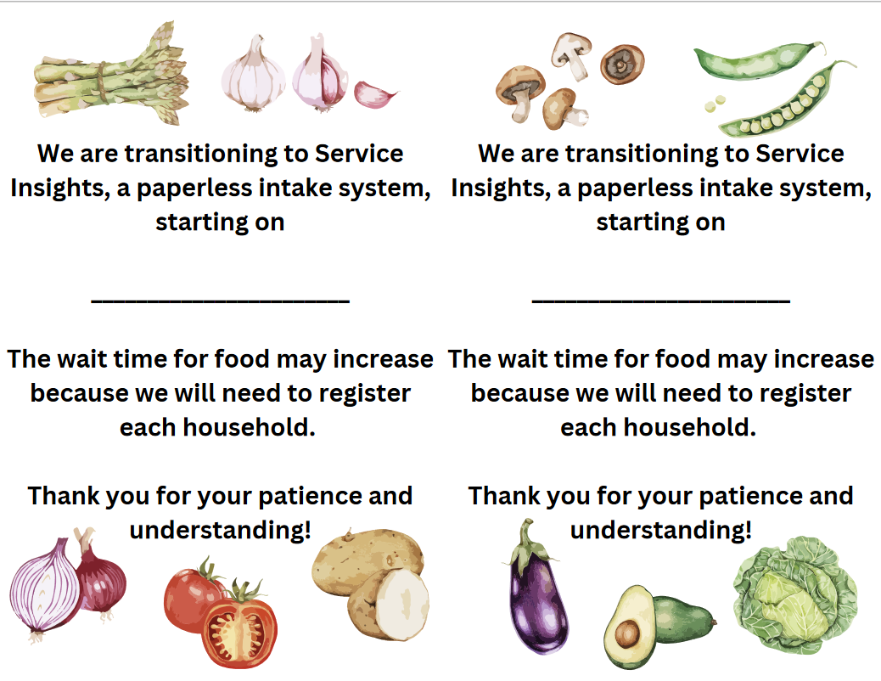
Informing Clients about SI
Start informing clients before you start using Service Insights
Use our flyer or your own
Notes:
Update flyer with final draft

Slide 17
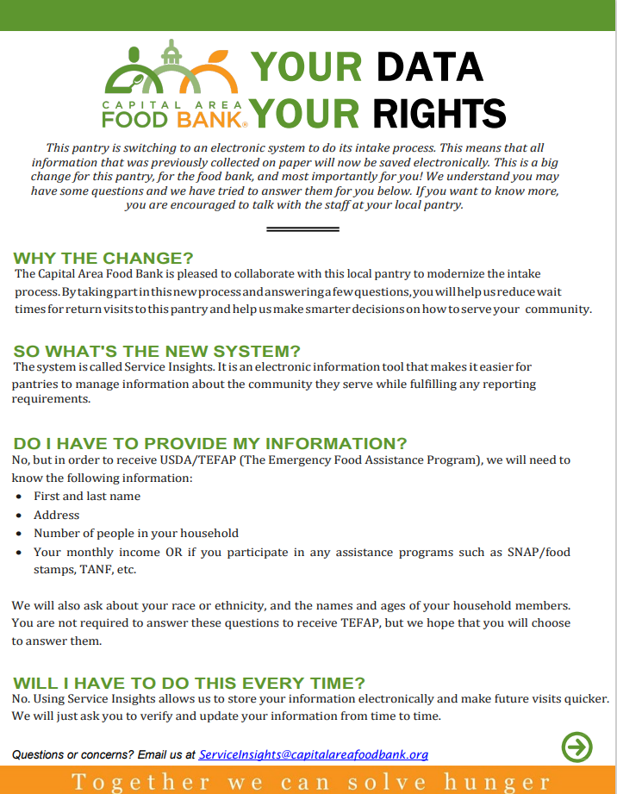
Translations Available
English
Spanish
Amharic
Arabic
Dari
Farsi
French
Korean
Mandarin
Oromo
Pashto
Polish
Tagalog
Urdu
Notes:
Clients must have the opportunity to review this info or have it explained to them before agreeing to be in Service Insights

Slide 18
What if someone doesn’t want to register?
We will record whatever amount of info they are comfortable with.
If someone does not want to sign up in Service Insights at all, they should still receive food.
Notes:
Mention anonymous visit

Slide 19
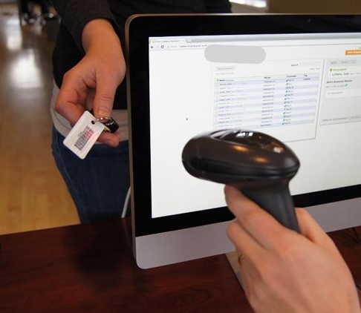
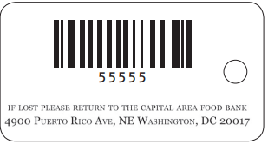
CAFB provides equipment to support you!
One laptop (if needed)
A barcode scanner
Keycards for your clients
Notes:
Illustration of our keycard front and back – maybe video

Slide 20
Expectations of CAFB
Set up your organization in Service Insights
Create users for all your volunteers using SI
Help strategize how to use SI at your site
Assist at your site when you “go live”
Continuous system support

Slide 21
Do we have to register everyone at once?!
No one expects you to register all your clients at one time!
Consider a goal for each distribution day
Ex: “We’ll register 10 clients at each distribution.” “We’ll register every third person in line.”
Let’s start communicating with clients about the new intake system coming soon

Slide 22
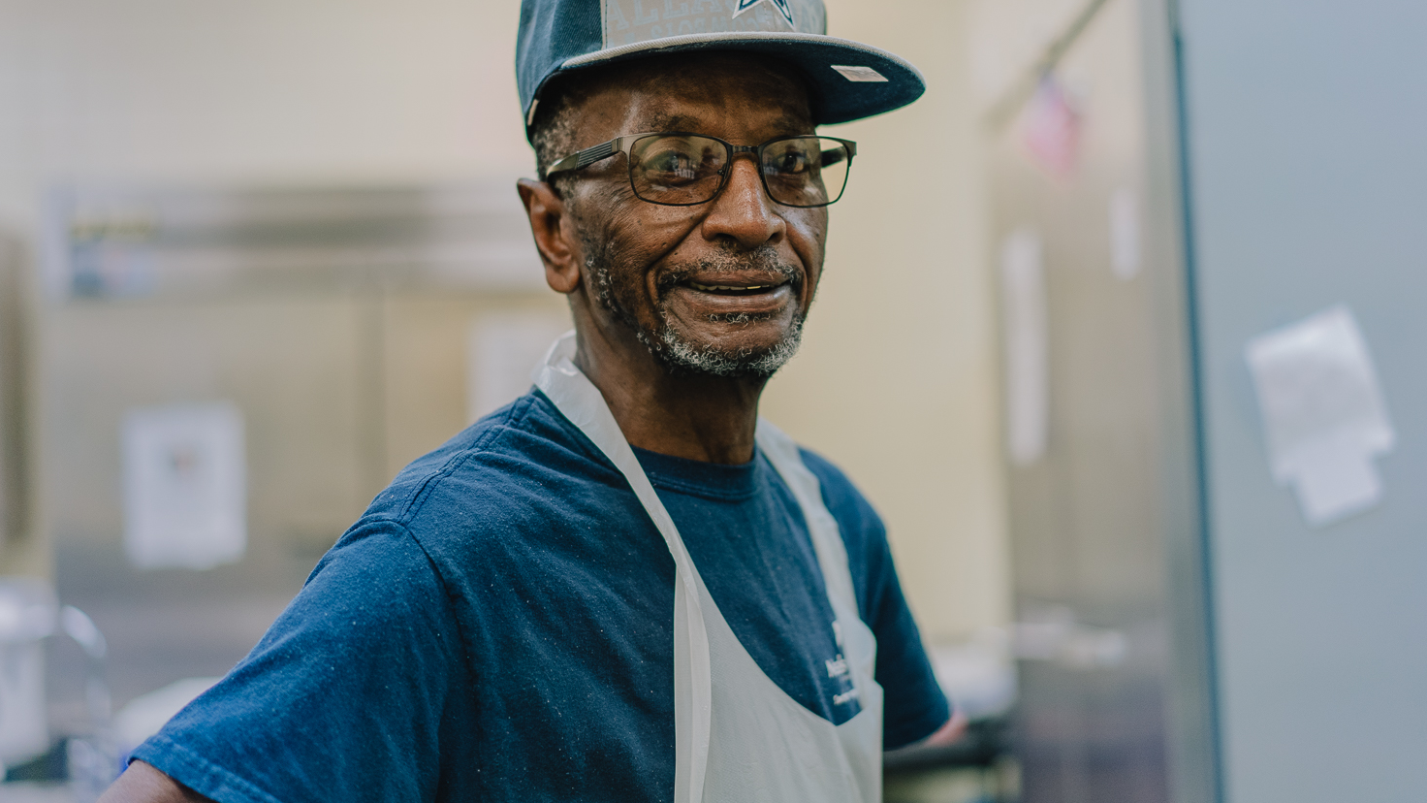
Service Insights Demonstration

Slide 23
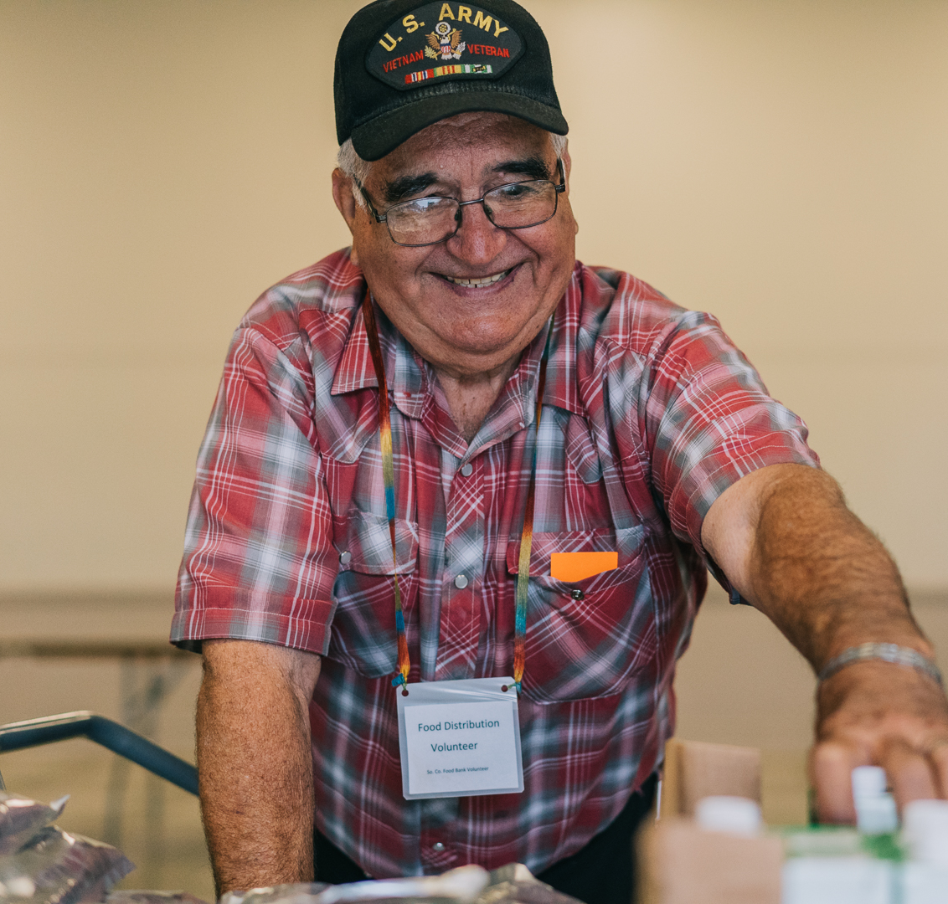
Service Insights demonstration includes:
Logging in
Tour the website layout
Search for a client
How to create a new client profile
Return visits
Possible duplicates
Spur-of-the-moment events
Anonymous Visits

Slide 24
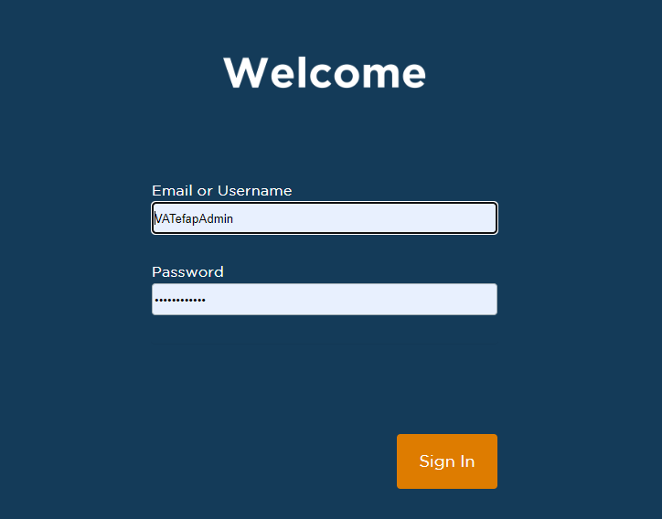
Service Insights Test Site
https://training.neighborintake.org/home
Notes:
[Log into the Service Insights test account to show them the system and the intake questions. Do not have trainees log in yet as it will take them awhile to log-on, they will be distracted, and without a fake client to input into the system they will not be able to go further than the Personal section anyways.]

Slide 25
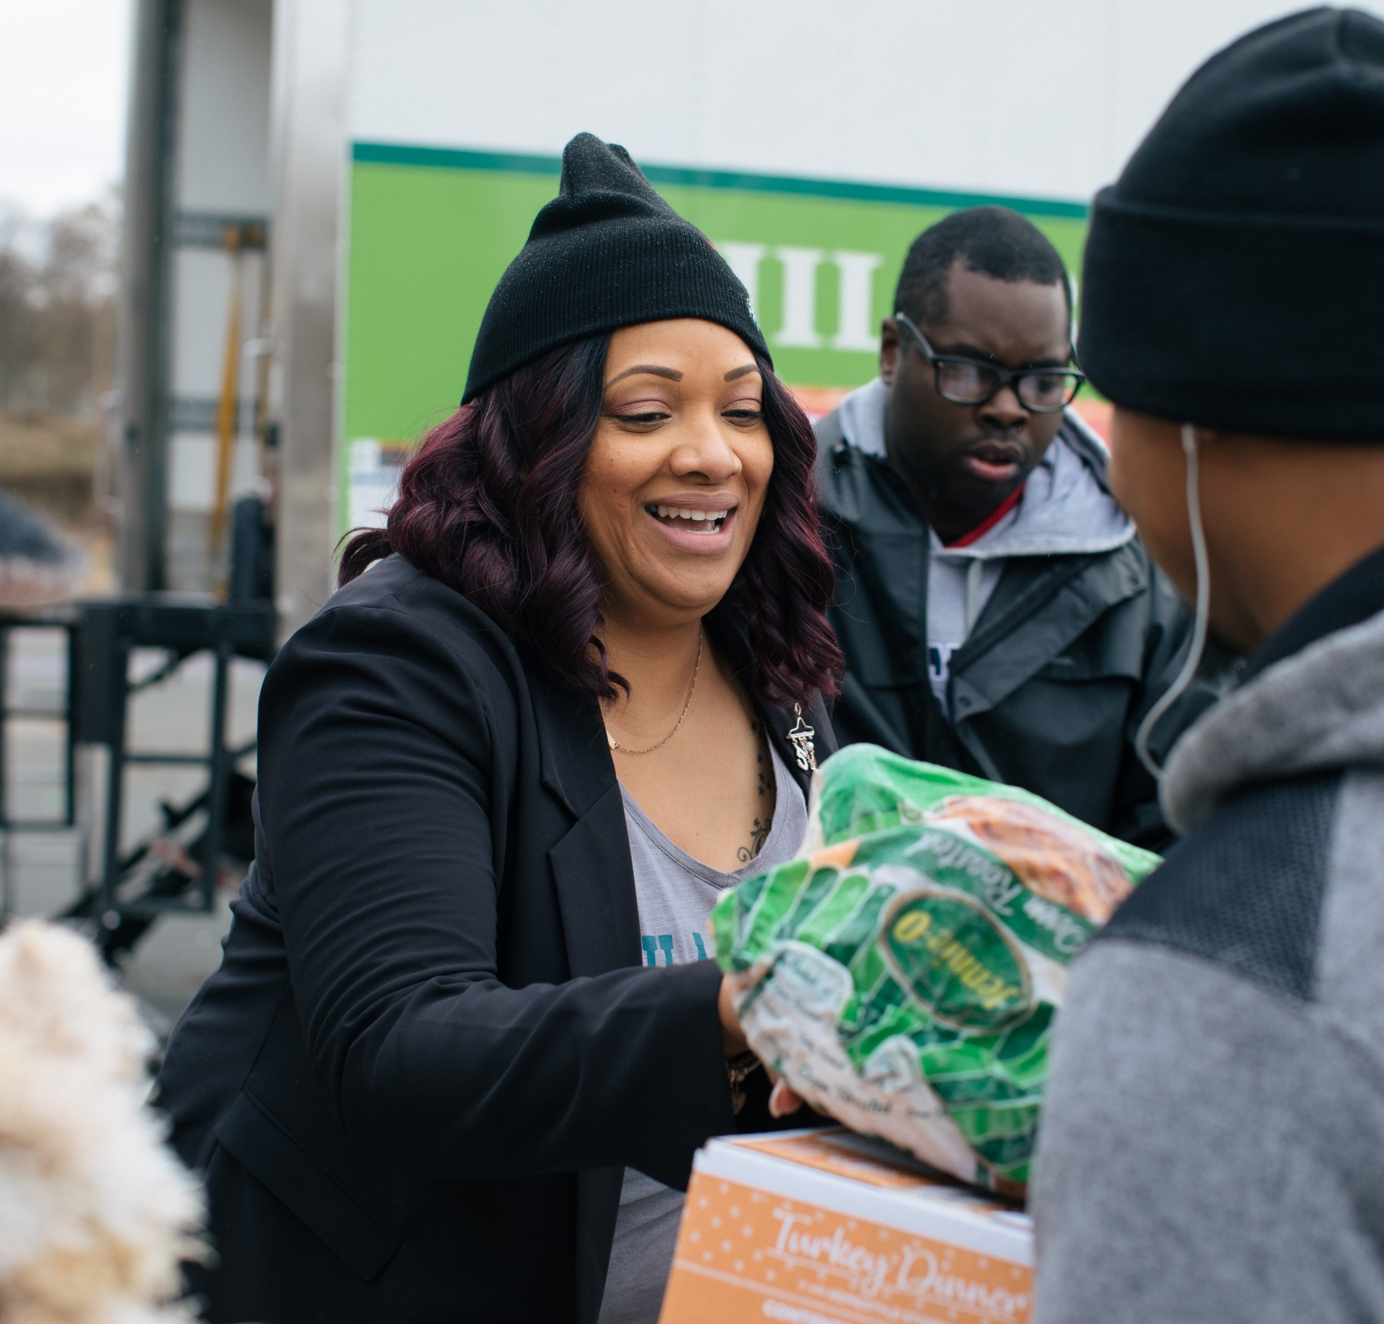
Training the Team
Share the video of this training with volunteers
and/or
Set a date for you to train volunteers in person
Share test site login and ask all volunteers to practice
Share how SI will benefit your organization
The CAFB team can help answer their questions or concerns
Notes:
Share info about system to ALL volunteers, not just those who will use SI

Slide 26
Reports
We’ll meet about reports when you have data in your system! (a few weeks from now)
Types of data you’ll get in reports:
# of households and individuals served
Age groups served
Areas where your clients live
Notes:
Types of information you’ll be able to get in reports: # of hh, # of individuals, breakdown of age groups, areas where clients live/are coming from
Some reports are still be developed by FA.
We’ll meet to go over reports to make sure you’re comfortable retrieving the information you need

Slide 27
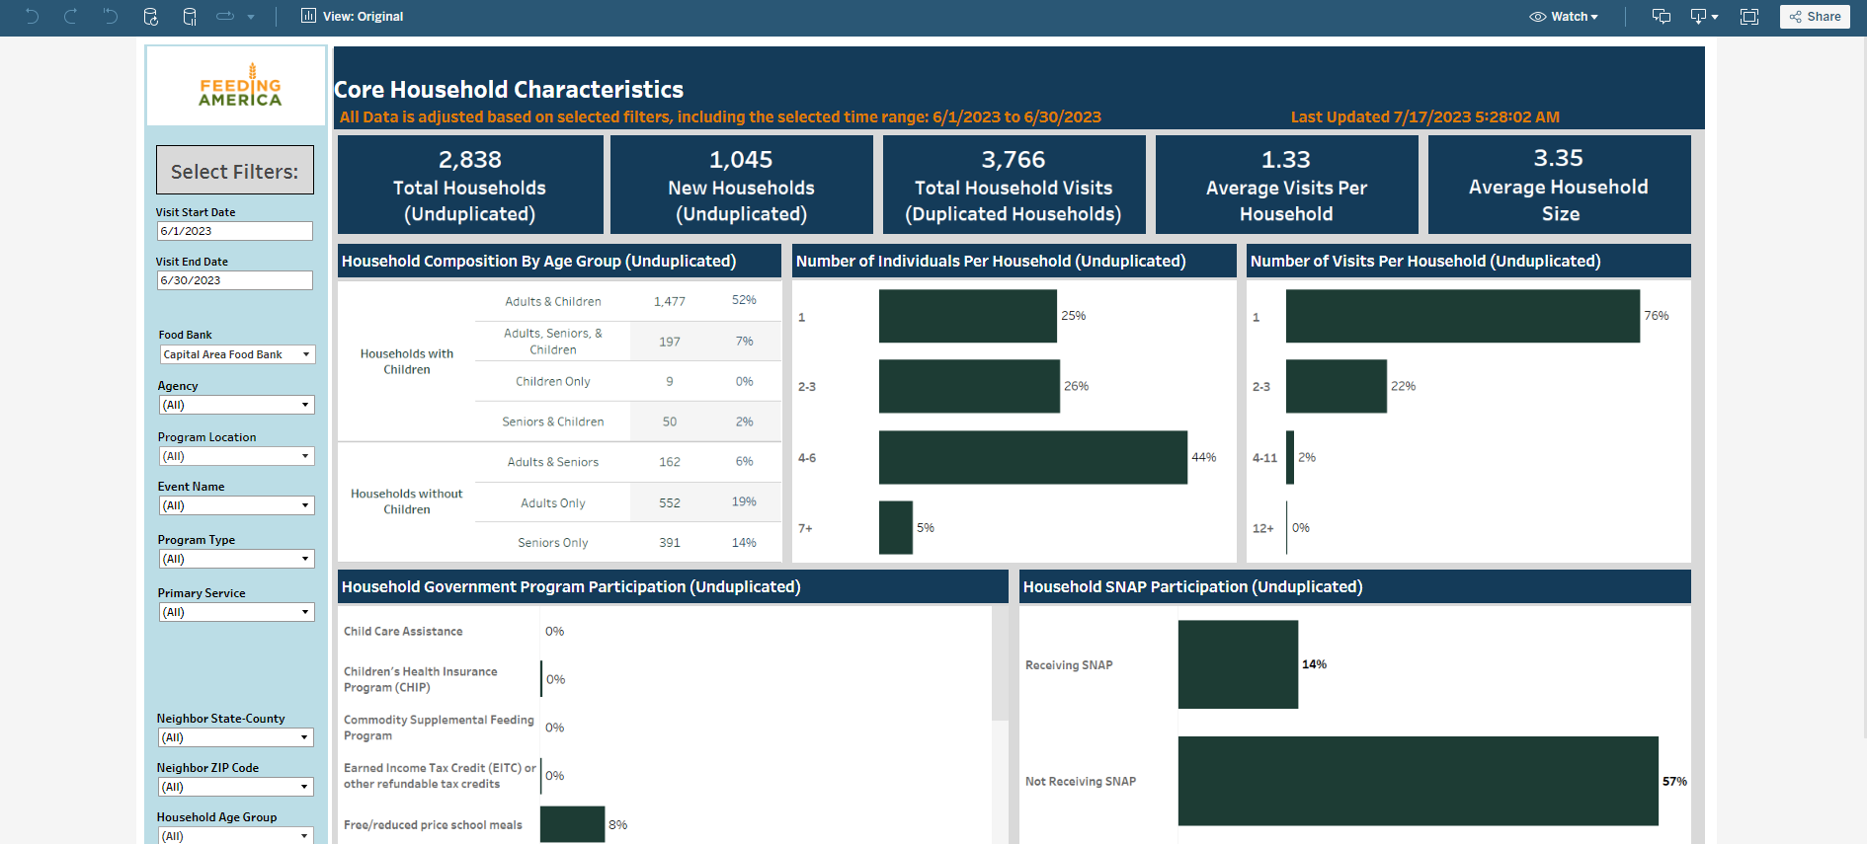
Report Example

Slide 28
Starting with Live Client Intake
CAFB Recommended!
Live client intake means that you are asking clients questions and entering their information directly into Service Insights while they are present.
Benefits
You can go paperless
Required
Multiple devices
Less work after the distribution ends
Greatly increases accuracy of info
Multiple volunteers using SI
Space for conversation with clients (w/privacy)

Slide 29
Starting with Paper Intake
Paper intake means that you ask clients to complete paper forms and enter their info into Service Insights after your distribution ends.
Benefits
Less close contact with clients
Required
More volunteer time after the distribution
Can make the line go faster
Need to check completed forms carefully before client leaves!

Slide 30
The Onboarding Process
Today’s Training
Volunteers are Trained & Informed
Clients are Informed
Start with Paper Forms
Start with Live Client Intake
Majority of Regulars are in Service Insights
Using Service Insights Live!
Notes:
Arrows needed or slide animation (either option visible at one time)

Slide 31
Goals after today’s training
Each volunteer should log into the test site and create at least 3 fake client profiles & record visits. Have fun with it!
I will email this presentation, your User Manual, and an online form for you to complete.
I will follow up with your Agency Manager in about 1 week to see how it’s going! ☺ We’ll schedule a time for you to receive your laptop and barcode scanner.
You will consider…
Will you start with paper intake forms or live intake?
When will your volunteers receive training?
When will you start sharing info about SI with clients?
We’ll decide when you want to “go live” with SI. I’ll be there to help! We can strategize together how you’ll incorporate SI at your pantry.

